Slide 1
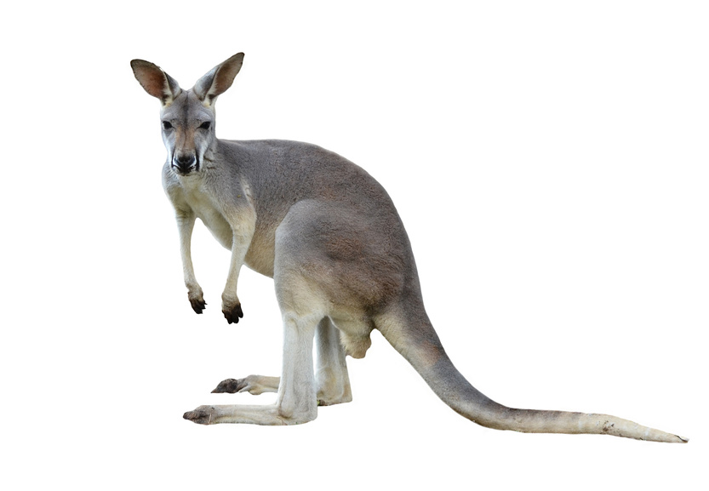
Slanted Triangles
Code-Along

Slide 2
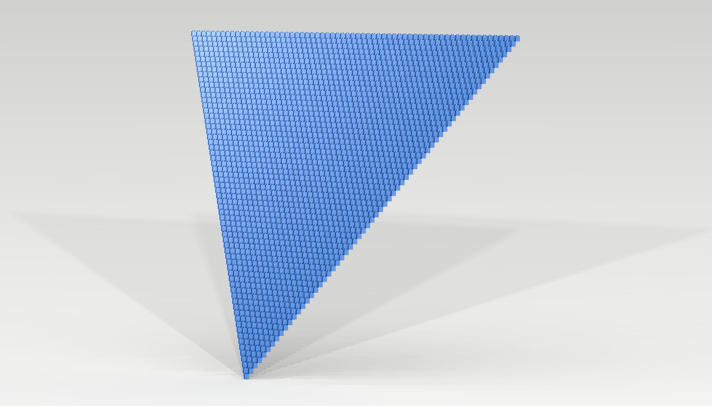
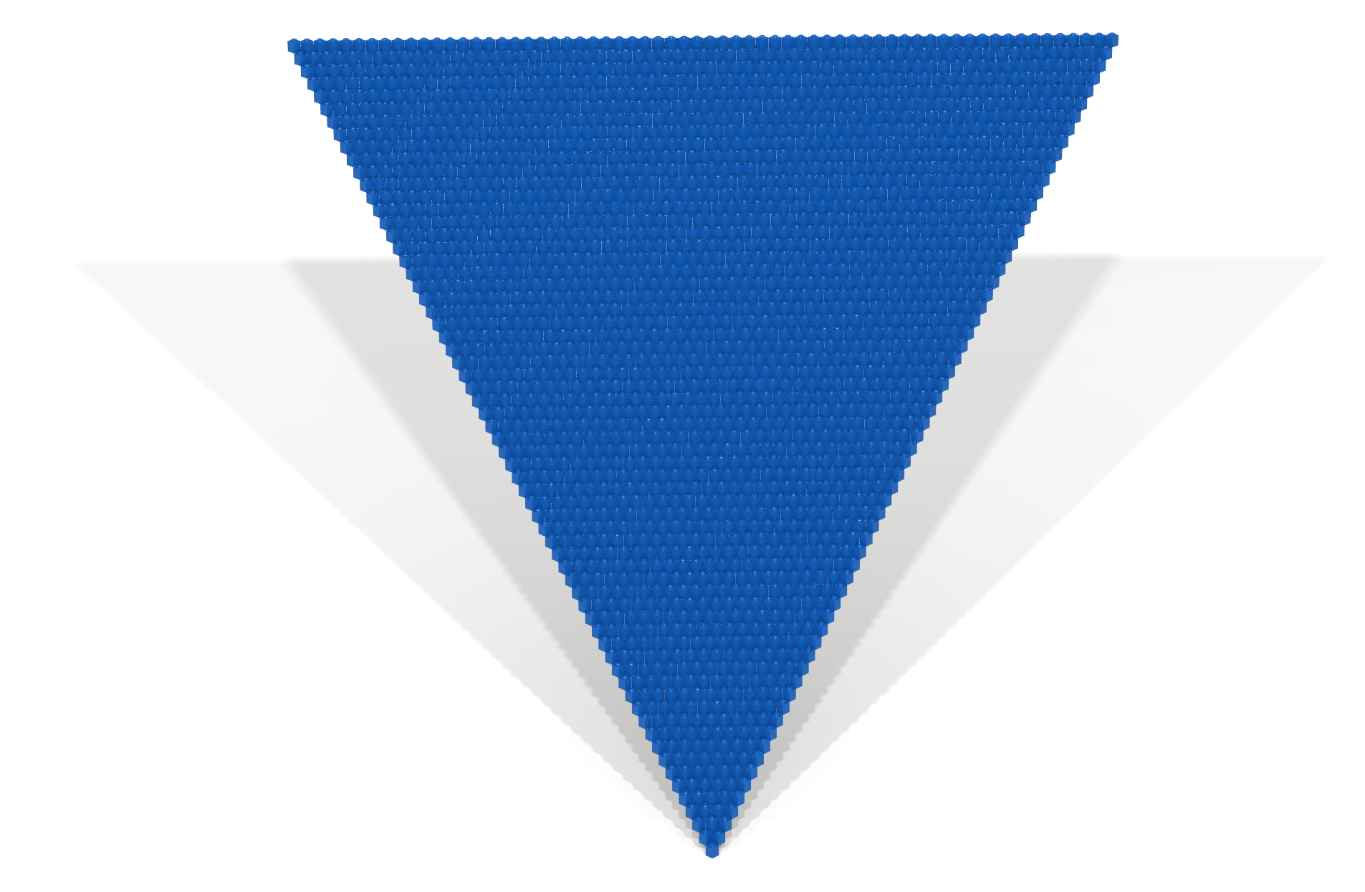
Example 1
Creating a slanted triangle

Slide 3
Example 1
In this example, an artifact will be constructed using the following property p.
p (x,y,z) ≝ x – y + z = 0

Slide 4
The Code
open Level_5;
val d = 64;
val max = d - 1;
fun brickFn (x,y,z) = if x - y + z = 0 then BLUE else EMPTY;
build (d,d,d);
traverseWithin (0,0,0) (max,max,max) brickFn;
show “slanted triangle”

Slide 5
Analysis
The linear Diophantine equation x + z = n

Slide 6
Table: Evaluation of the property p for different coordinates.
(x,y,z) | x – y + z = 0 | Comment
(0,0,0) | true | Coordinate (0,0,0) satisfies p.
(1,0,0) | false | Coordinate (1,0,0) does not satisfy p.
(0,1,0) | false | Coordinate (0,1,0) does not satisfy p.
(0,0,1) | false | Coordinate (0,0,1) does not satisfy p.
(1,1,0) | true | Coordinate (1,1,0) satisfies p.
(0,1,1) | true | Coordinate (0,1,1) satisfies p.
(1,1,1) | false | Coordinate (1,1,1) does not satisfy p.
Observe: x – y + z = 0 is semantically equivalent to x + z = y

Slide 7
Evaluating x + z = y for a fixed value of y
y = 0 → { (0,0,0) }
y = 1 → { (1,1,0), (0,1,1) }
y = 2 → { (2,2,0), (1,2,1), (0,2,2) }
Question: How many points satisfy p when y equals n?
AKA: How many non-negative integer solutions are there
to the linear Diophantine equation x + z = n?
potayto potahto

Slide 8
Using sets to model the problem when y = 4
union
=
union
=
.
.
.
.
.
.
.
.
.

Slide 9
Using unary notation to model the problem
x + z = ||||
0 + |||| = ||||
| + ||| = ||||
|| + || = ||||
||| + | = ||||
|||| + 0 = ||||
Observe: When y = 4, there is a solution for all values of x in the range 0…4

Slide 10
In general
When y = n, the following xz coordinates will satisfy the property.
(0,n) … (n,0)
Expressing this using 3D coordinates give us the following.
(0,n,n) … (n,n,0)
Ideally, we would formally prove all of this.

Slide 11
Code Restructuring 1
open Level_5;
val d = 64;
val max = d - 1;
fun brickFn (x,y,z) =
let
val putBlue = x - y + z = 0;
in
if putBlue then BLUE else EMPTY
end;
build (d,d,d);
traverseWithin (0,0,0) (max,max,max) brickFn;
show "slanted triangle";

Slide 12
Code Restructuring 2
open Level_5;
val d = 64;
val max = d - 1;
fun shouldBeBlue (x,y,z) = x - y + z = 0;
fun brickFn point =
let
val putBlue = shouldBeBlue point;
in
if putBlue then BLUE else EMPTY
end;
build (d,d,d);
traverseWithin (0,0,0) (max,max,max) brickFn;
show "slanted triangle";

Slide 13
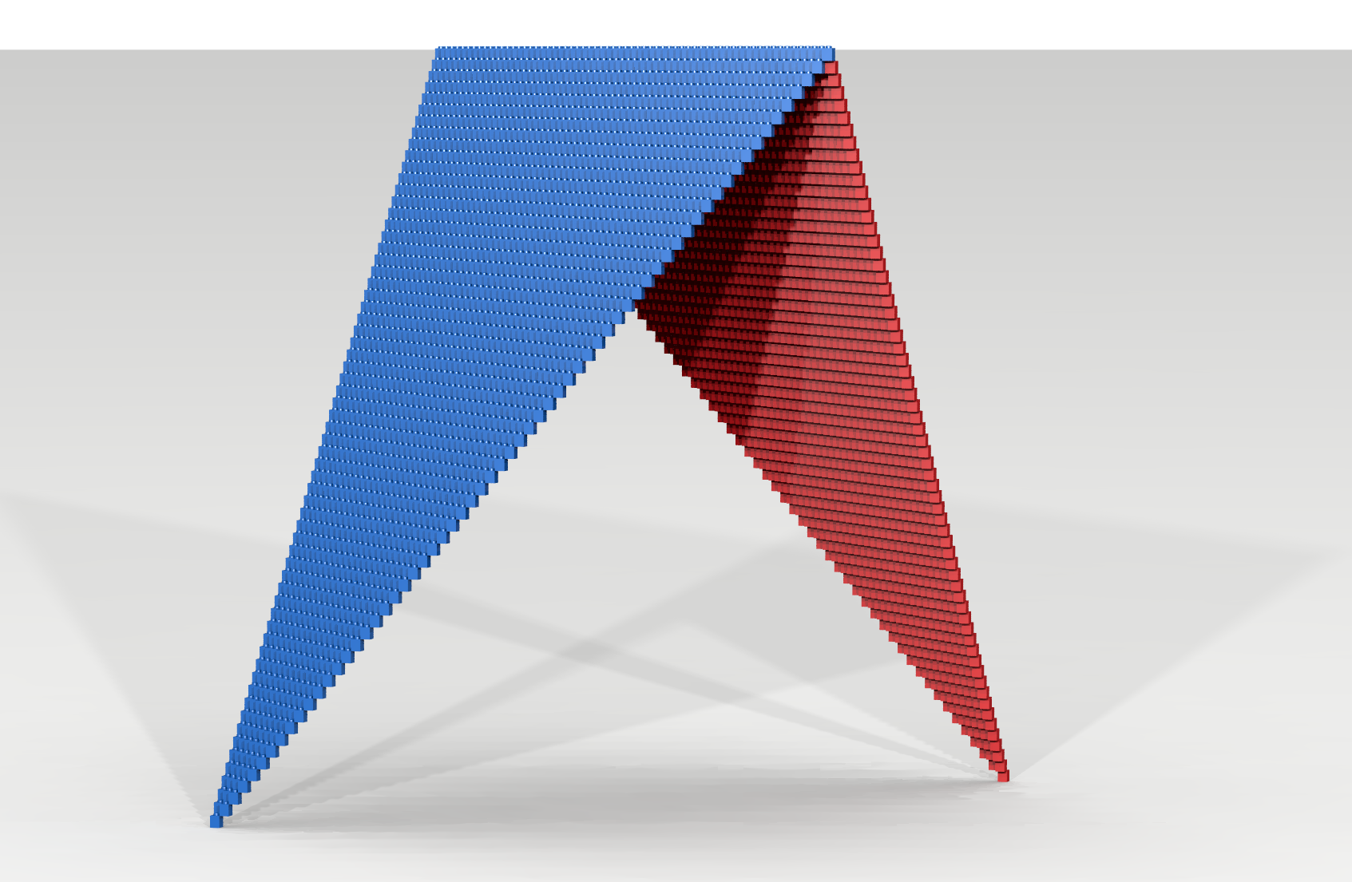
Example 2
Adding a second slanted triangle

Slide 14
Objective
We would like to add a similar slanted triangle that begins with a single RED bit-brick at (max,0,max) and also ends with a diagonal row of RED bricks over the following range:
(0,max,max) … (max,max,0)
Note that the shape of the RED triangle that we are constructing is equivalent to the shape of the BLUE triangle created by the predicate p.
Aside from their color, the only difference between the two triangles is their orientation. Knowing this, it should be possible to create a function that translates (i.e., maps) points in the RED triangle to corresponding points in the BLUE triangle.

Slide 15
Table: Corresponding points in the xz-plane when y = 3.
BLUE Artifact | RED Artifact
(3,0) | (max – 3, max – 0)
(2,1) | (max – 2, max – 1)
(1,2) | (max – 1, max – 2)
(0,3) | (max – 0, max – 3)
Can you see the pattern that connects RED cells with corresponding BLUE cells?

Slide 16
A mapping
max
max
0
0

Slide 17
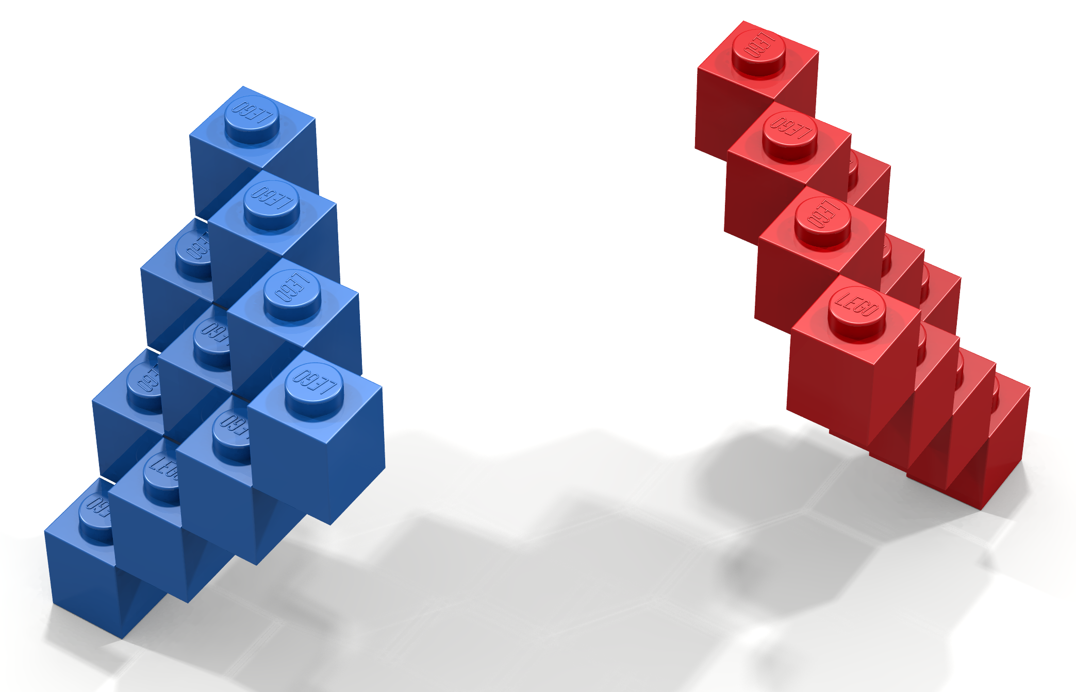
Question:
Suppose you were told that the coordinate (x,z), for some unknown value of y, contained a BLUE brick. What is the corresponding coordinate that contains a RED brick?
(0,3,3)
(max - 3,3, max - 0)
(max - 0,3, max - 3)
(3,3,0)
Answer:
The coordinate containing the corresponding RED brick is (max – x, max – z).

Slide 18
Question:
Suppose you were told that the coordinate (x,z), for some unknown value of y, contained a RED brick. What is the corresponding coordinate that contains a BLUE brick?
(0,3,3)
(max - 3,3, max - 0)
(max - 0,3, max - 3)
(3,3,0)
Answer:
The coordinate containing the corresponding BLUE brick is (max – x, max – z).

Slide 19
The following expression specifies the correspondence between BLUE/RED and RED/BLUE cells for an arbitrary xz-plane.
(x,z) ⇔ (max – x, max – z)
Specifically, (x,z) contains a BLUE brick if and only if (max – x, max – z) contains a RED brick.
Furthermore, it is also the case that (x,z) contains a RED brick if and only if (max – x, max – z) contains a BLUE brick.
Our last analysis step is to include y in our correspondence. The inclusion of y, shown below, turns out not to be difficult. Why?
(x,y,z) ⇔ (max – x, y, max – z)

Slide 20
At this point we have defined a correspondence between the BLUE and RED artifacts.
This allows us to translate points that belong to the RED artifact to corresponding points in the BLUE artifact and vice versa.
In a formal setting, such translations are typically called mappings.
In mathematics, different kinds of mappings are studied. The kind of mapping we have defined here is special and is called a one-to-one correspondence. A one-to-one correspondence is also referred to, in more technical terms, as a bijection.

Slide 21
The following SML function implements the one-to-one correspondence we have defined.
fun map (x,y,z) = (max – x, y, max – z)

Slide 22
Using the function map, we will construct the BLUE and RED as follows.
Our program will traverse the virtual space (0,0,0) … (max,max,max) and will do the following for each coordinate encountered.
Check to see if a BLUE brick should be placed at the coordinate. That is, check to see if the coordinate satisfies the property p.
If not, then check to see if a RED brick should be placed at the coordinate. This can be done by checking to see if the mapped coordinate satisfies the property p. If so, then a RED brick should be put at the (unmapped) coordinate.

Slide 23
open Level_5;
val d = 64;
val max = d - 1;
fun map (x,y,z) = (max - x, y, max - z);
fun shouldBeBlue (x,y,z) = x - y + z = 0;
fun shouldBeRed point = shouldBeBlue (map point);
fun brickFn point =
let
val putBlue = shouldBeBlue point;
val putRed = shouldBeRed point;
in
if putBlue then BLUE
else if putRed then RED
else EMPTY
end;
build (d,d,d);
traverseWithin (0,0,0) (max,max,max) brickFn;
show "slanted triangle";

Slide 24
Variations
Adding more slanted triangles

Slide 25
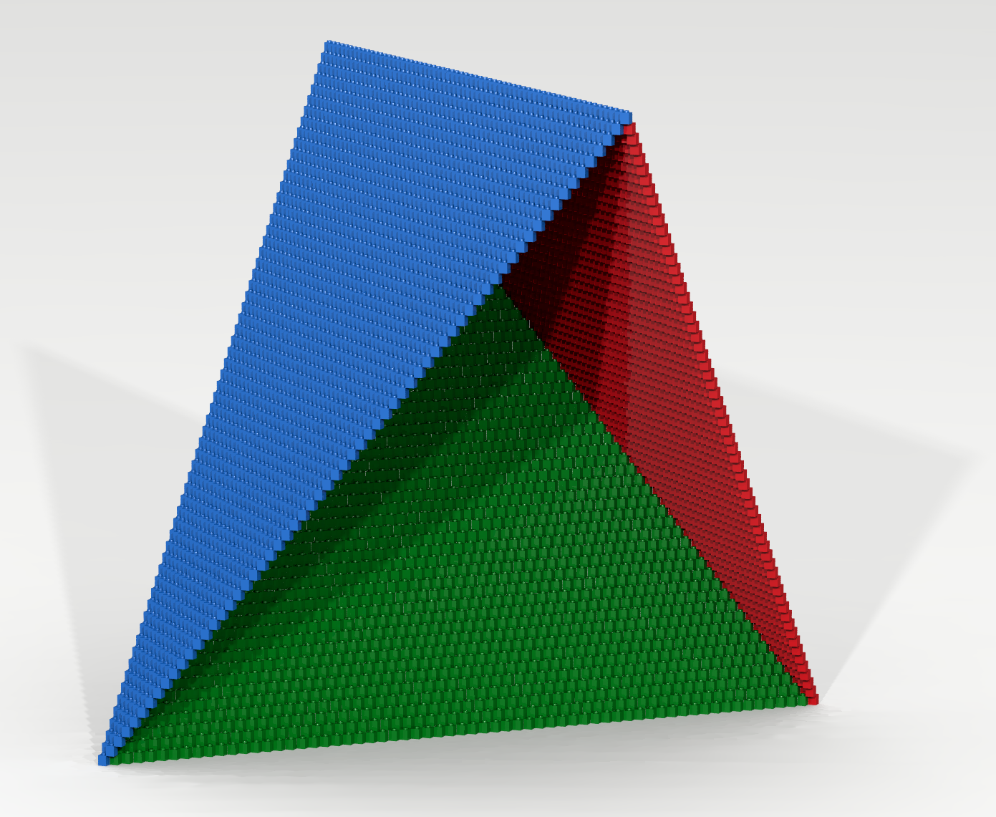
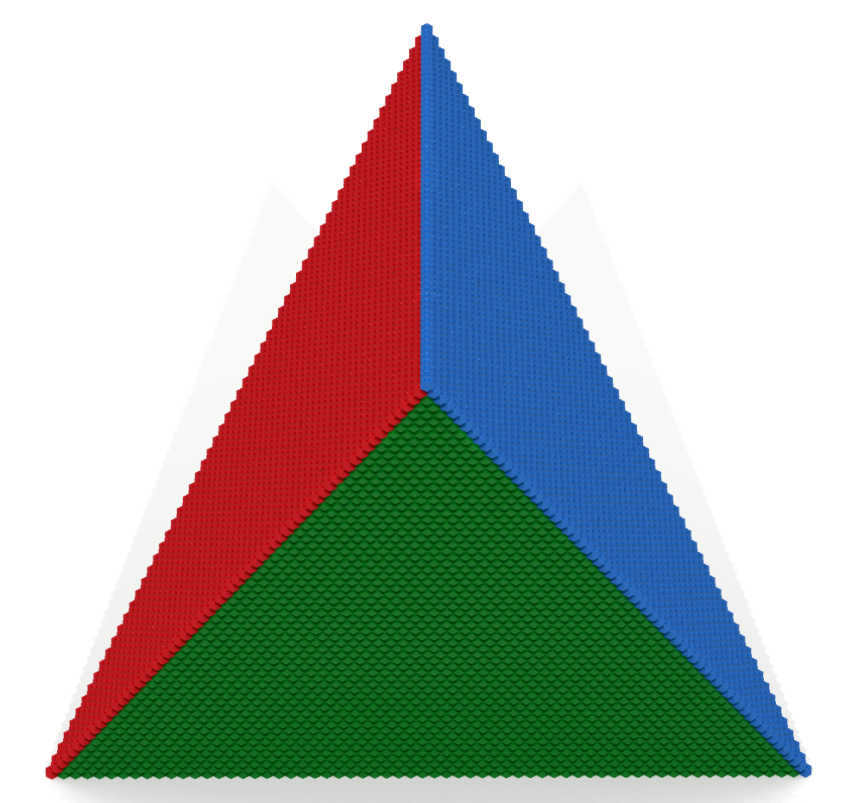

Slide 26
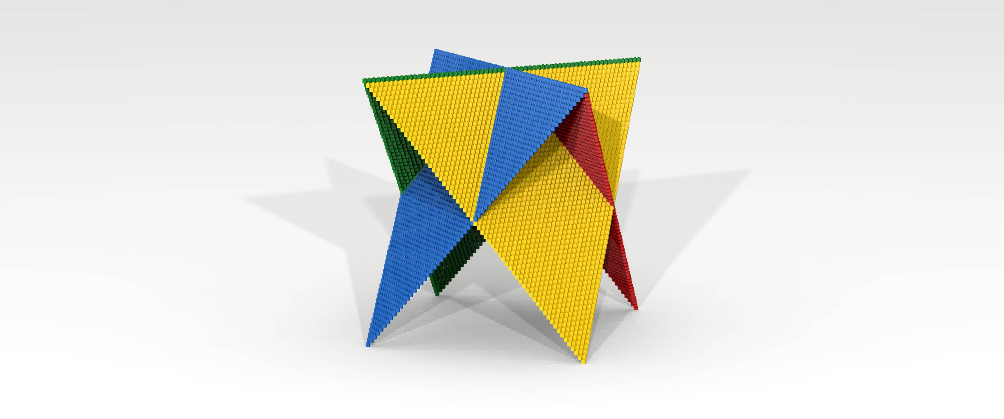

Slide 27
